Slide 1
Summary:
Walter Stafford Symposium on the Structure of Race and Inequality in New York City
October 13th and 14th 2016
At
Robert Wagner School for Public Service, New York University

Slide 2
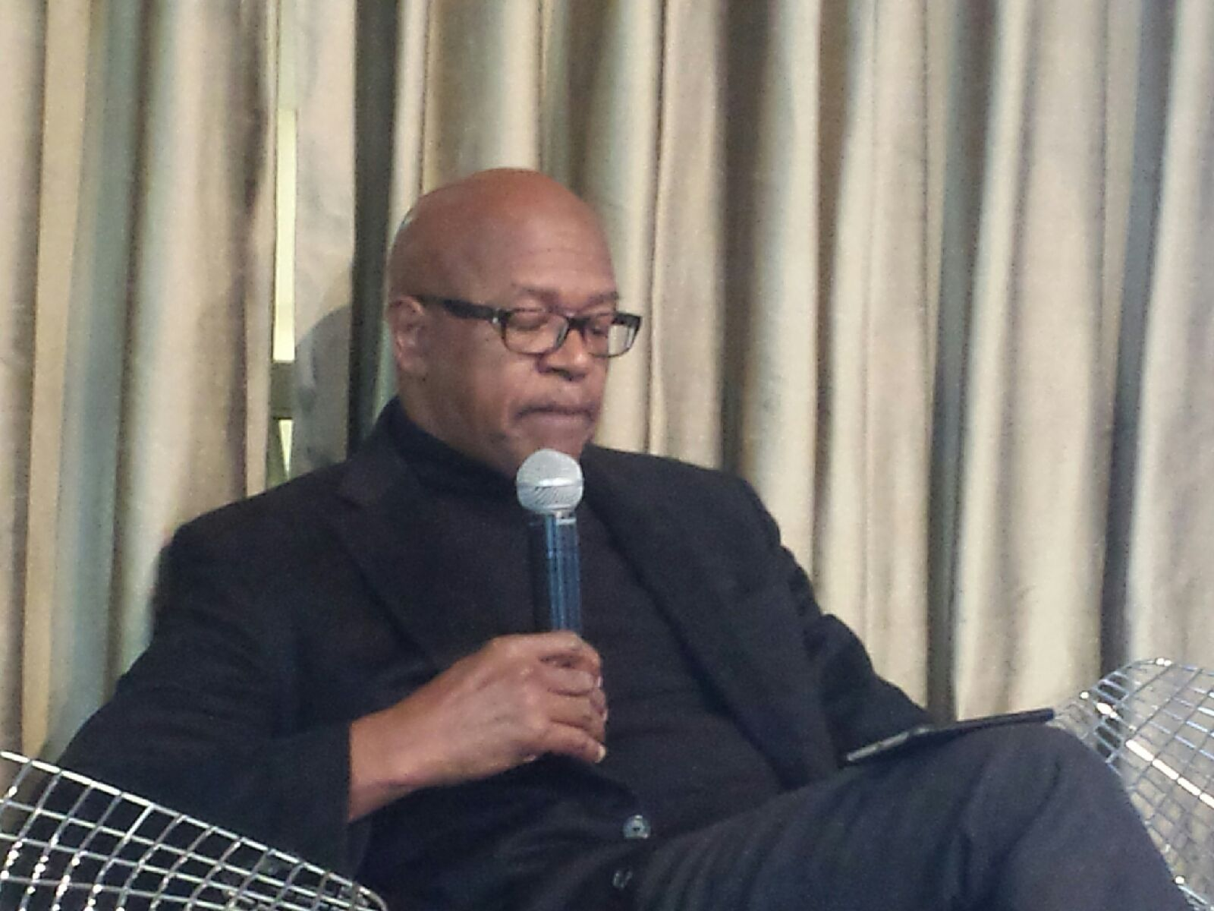
Keynote:
Elijah Anderson, Yale university
Symbolic racism + iconic ghetto
Stigma of poverty & racism that fuels implicit bias, stigmatizes blacks, obscures black middle class, and exceptionalizes talent
Iconic ghetto and symbolic racism exist across both black and white spaces
Ultimately reinforces slave status for blacks

Slide 3
Economy, Jobs, Income
Presenter: James Parrott, Fiscal Policy Institute
Reviewers/Commentators: Donald Davis, columbia University, ronnie Lowenstein, NYC independent budget office, teofilo reyes, restaurant opportunities centers united
Race & class in NYC manifested through income inequality
One Percent’s share of income growing, in part due to financial sector prominence in city’s economy, alongside economic influence over policy change
Federal policy often undermined cities through urban austerity and suburbanization
Growth of NYC economy and shift to financial center did not translate to wage growth
For low-income, immigrant, and POC populations, most job growth in low-wage sector
Government austerity cuts eliminated many professional jobs for POC

Slide 4
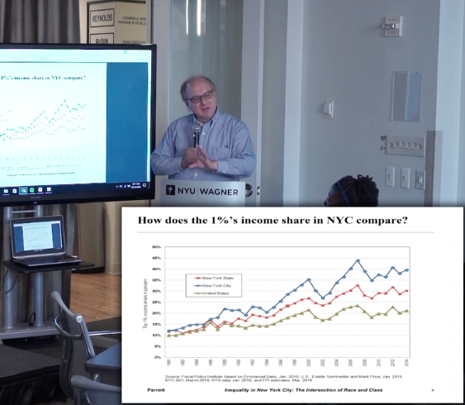
Pictured: James Parrott

Slide 5
Donald Davis, Professor and chair of economics at columbia university
Historical factors in NYC populations shifts; black population down 15% over 70s-80s
Economic and decline in manufacturing major factors
Financialization, as well as immigration, helped restructure and revive economy
Also factors into urban segregation and ‘tipping’ of neighborhoods with changing racial demographics

Slide 6
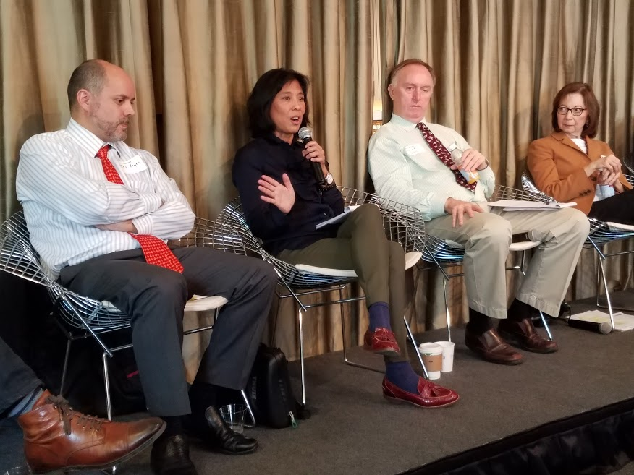
Left to right:
Teofilo Reyes
Barbara Chang
Donald Davis
Ronnie Lowenstein

Slide 7
Ronnie Lowenstein, NYC Independent Budget office
NYC 2008 recession relatively mild for overall economic growth
Mix of industries allowed NYC to fare better in employment, but still no gains in wages
Renter market of NYC insulated city from nationwide mortgage crash
Also due to corporate tax incentive, and NYC’s highest personal income tax

Slide 8
Teofilo Reyes, restaurant opportunities center united
20% Restaurant industry living at or below poverty level
Racialized occupations, majority of POC in ‘back of house’ low-wage service positions; whites in well paid ‘front of house’ positions
Also gendered inequality, with most female workers relying on tips and left outside the minimum wage discourse, alongside little protections against sexual harassment
Legacies of racism; tips seen as degrading and used as wages for POC

Slide 9
Panel Takeaways:
Race and inequality in NYC plays out in part through severe income inequality
Wages remain stagnant despite overall NYC economic growth
City’s economic status not a reliable indicator of equality or opportunity for low-income New Yorkers of color

Slide 10
Metropolitan dynamics of racialized inequality
Presenters: Benjamin Bowser, symposium co-organizer and Professor Emeritus at Cal. State University, Kristen Lewis and Sarah Burd-Sharps, Measure of America
Reviewers: Dianne Morales, Director of Phipps Neighborhood, Sarah Ludwig, the New Economy Project, james parrott, fiscal policy institute
Spatial dynamics of racism historically constructed
30% of NYC population black in 1660, crucial in literally constructing the city, as both indentured class, and free black communities (Greenwich Village, Catherine Street, Central Park site)
Displacement of communities of color happening for generations; historicizes gentrification and push of black communities from Lower Manhattan further uptown (Harlem) and into Brooklyn (BedStuy)
Connected to legacies of racialization and colonization; blacks used as buffer against Native communities, and then displaced with influx of immigrants as labor force
Racialized hierarchy used to maintain divisions and suppress resistance
1714, blacks barred from owning property, creating a racialized renter class in NYC

Slide 11
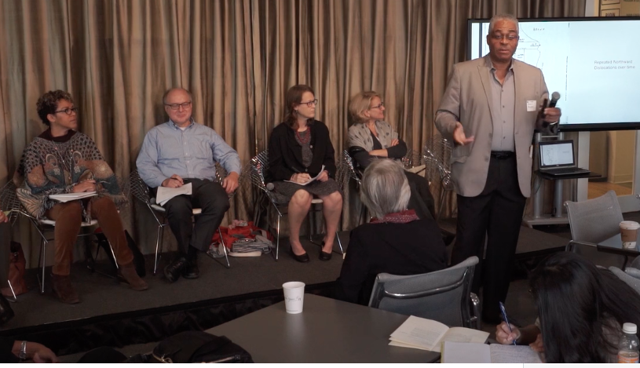
Left to right:
Dianne Morales,
James Parrott,
Sarah Ludwig, Sarah Burd-Sharps,
Benjamin Bowser

Slide 12
The five new yorks
Presenters: Kristen Lewis and Sarah Burd-Sharps, Measure of America
Reviewers: Dianne Morales, Director of Phipps Neighborhood, Sarah Ludwig, the New Economy Project, james parrott, fiscal policy institute
Alternative criteria and measures for success in NYC outside of traditional economic measures like GDP etc.
‘Human Development Index’ measures factors like health, standard of living, life expectancy, degree enrollment, median personal earnings etc.
Categorized NYC into ‘Five New Yorks’ based on this human measure, and defined by degrees of opportunity
Racialized breakdown, people of color in the most precarious position regarding housing, income, employment and other living conditions

Slide 13
Sarah Ludwig, New economy project
Urban inequality through race and place; structural causes shape neighborhoods resulting in racial segregation, and racial disparities in income, housing, and policing, etc.
20% of blacks in NYC experience hypersegregation
Issues of inequality intersectional, ie. housing + health disparities
NYC communities of color shaped through various infrastructure and land use policies; midtown post office, Penn Station, Lincoln Center, and Brooklyn Bridge displaced formerly black communities

Slide 14
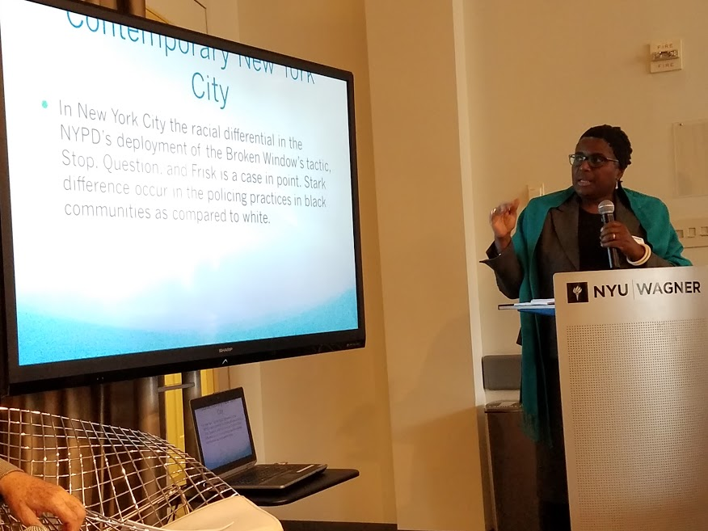
Effects of stop and frisk: a new construction of blackness presented by: Natalie Byfield, Professor of Anthropology and Sociology
Reviewers: Susan Shah, of the Vera Institute for Justice , David Rothenburg, fortune society, richard dudley, cuny institute for state and local governance
Stop & Frisk + race & place
Crime a historically variable category; not an objective measure of crime, danger, or disorder
Historical legacy of black codes, slave patrols, the convict-lease system etc.
Contemporary policing still racially discriminatory
NYC Stop & Frisk overwhelmingly targeted people of color, despite similar or higher rates of contraband for whites
Racialized policing even disproportionate against native black communities when compared to immigrant black communities in NYC
Disparities between stops and misdemeanors, rather than felonies due to ‘broken windows’ policing
Reproduces racial ‘social distance’

Slide 15
Culturally biased expert testimony in criminal and family proceedings presented by: stephen greenspan, Clinical Professor of Psychiatry, University of Colorado, Boulder
Racial biases systematic within legal system, as well as expert testimony
‘Intellectually disabled’ excluded from death sentence, most often granted to whites.
Majority of death row prisoners POC
‘Cultural/racial overshadowing’
Race most often overshadows other factors of defendant's
Points to systematic discrimination within mental health, and related fields, with experts having little to no training on race
Legacy of slavery, and pseudoscience where blacks were deemed ‘incapable of depression or mood disorders’
Factors create a pervasive forensic bias, evident in criminal and family proceedings that disadvantage families of color

Slide 16
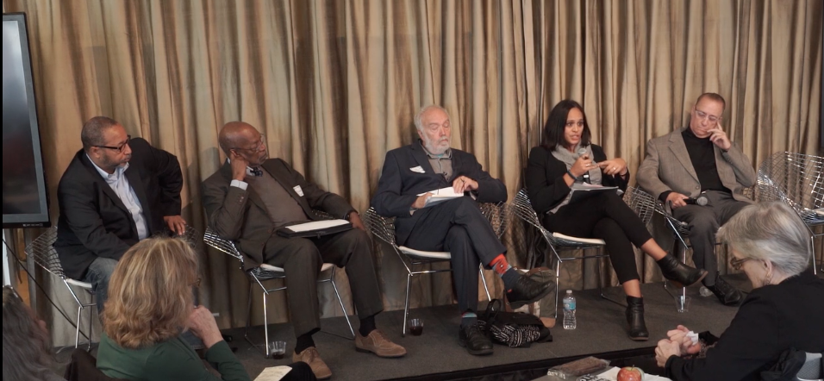
Susan shah, vera institute for justice
Junk Justice
Crisis in legal justice system
Criminal justice intensely local, indicative of race/inequality in NYC
Police as manifestation of society, rather than crime or danger
Resultant mass incarceration destabilizes families and entire communities of color
Data driven policing incentives enforcement and arrest as criteria for success

Slide 17
David rothenburg, fortune society
War on drugs and mass incarceration as tools of racial profiling and disenfranchisement
NYC role in war on drugs through Rockefeller Drug Laws
Blacker states with more restrictive voting right laws (ie Florida vs Vermont)
Policing not a response that stops crime, only punitive after the fact

Slide 18
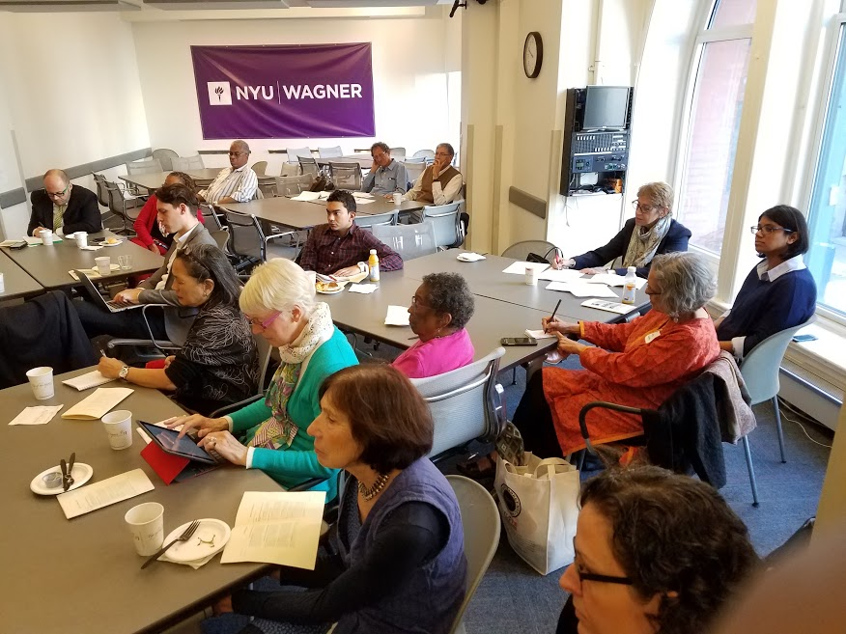
Immigration and mobility presenters: john flateau, medgar evers college, calvin holder, cuny staten island, aubrey bonnett, suny old westbury, hector cordero-guzman, cuny graduate center, howard shih, asian american federation reviewers: arthur paris, syracuse, colvin grannum, bedford stuyvesant restoration corporation, waldalba stewart, carribbean action lobby, tarry hum, queens college

Slide 19
African Americans and Political Inequality: Fifty Years of Struggle from 1965 – 2016 presented by John flateau, Medgar evers college reviewed by Arthur Paris, syracuse
Historical black migration from the south and white flight helped structure NYC racial inequality and segregation
Harlem and Brooklyn as a black communities result of restrictive real estate market
Black political power built through black community (Harlem and black electeds)
Undermining of black communities in NYC challenges sustainable black political agency
Truly affordable housing vital to maintaining political power for POC communities
Where is the next generation of POC leadership coming from? How to reconcile the advancement of POC in electoral politics and enduring structural racism?
Gerrymandering, disenfranchisement, and other barriers to POC political power, and divisive among diverse POC groups
Relative success and progress still does not equate to freedom or equality

Slide 20
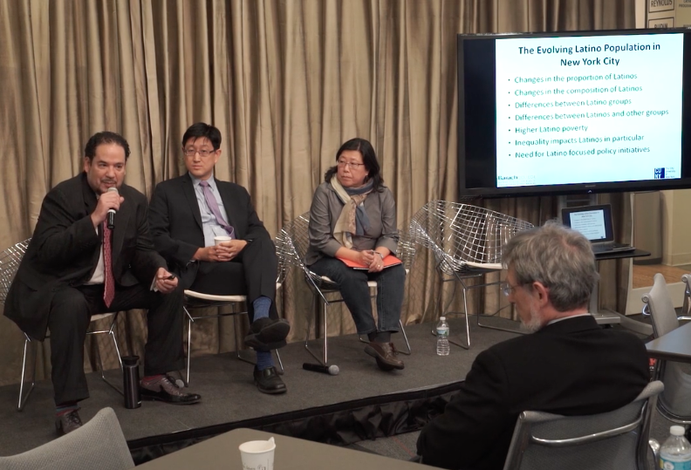
Latin American Immigration and Mobility presented by hector cordero-guzman, Baruch College
Latinos growing population in NYC at 29%
Latinos not a monolith, composed of varying groups (Puerto Ricans advantaged with citizenship status versus most groups)
Concentrated mostly in Brooklyn
Targeted for gentrification and redevelopment
Loss of place tied to erasure of cultural and historical spaces and communities

Slide 21
Asian and Asian American Immigration & Mobility
Presented by Howard shih, asian american federation reviewed by tarry hum, Queens college
1965 Asian immigration boom
Skilled workers and ‘model minority’ status
Higher income earners when compared to other immigrant groups of color
Poverty rates increasing, with disparities in English skills (less likely to use public assistance)
Industries with Asians in poverty: textiles, taxi, restaurants, manufacturing, and service sector
Growing inequality among Asians complicates standard ‘model minority’ narrative
Contemporary context of gentrification complicit in global finance and Asian investment in NYC housing markets
Loss of affordable housing and rent stabilization disadvantaging Asians and Asian Americans across NYC, and Chinatown, and making communities vulnerable to tenant harassment
Cross ethnic and cultural organizing necessary for pan-Asian movement against structural racism

Slide 22
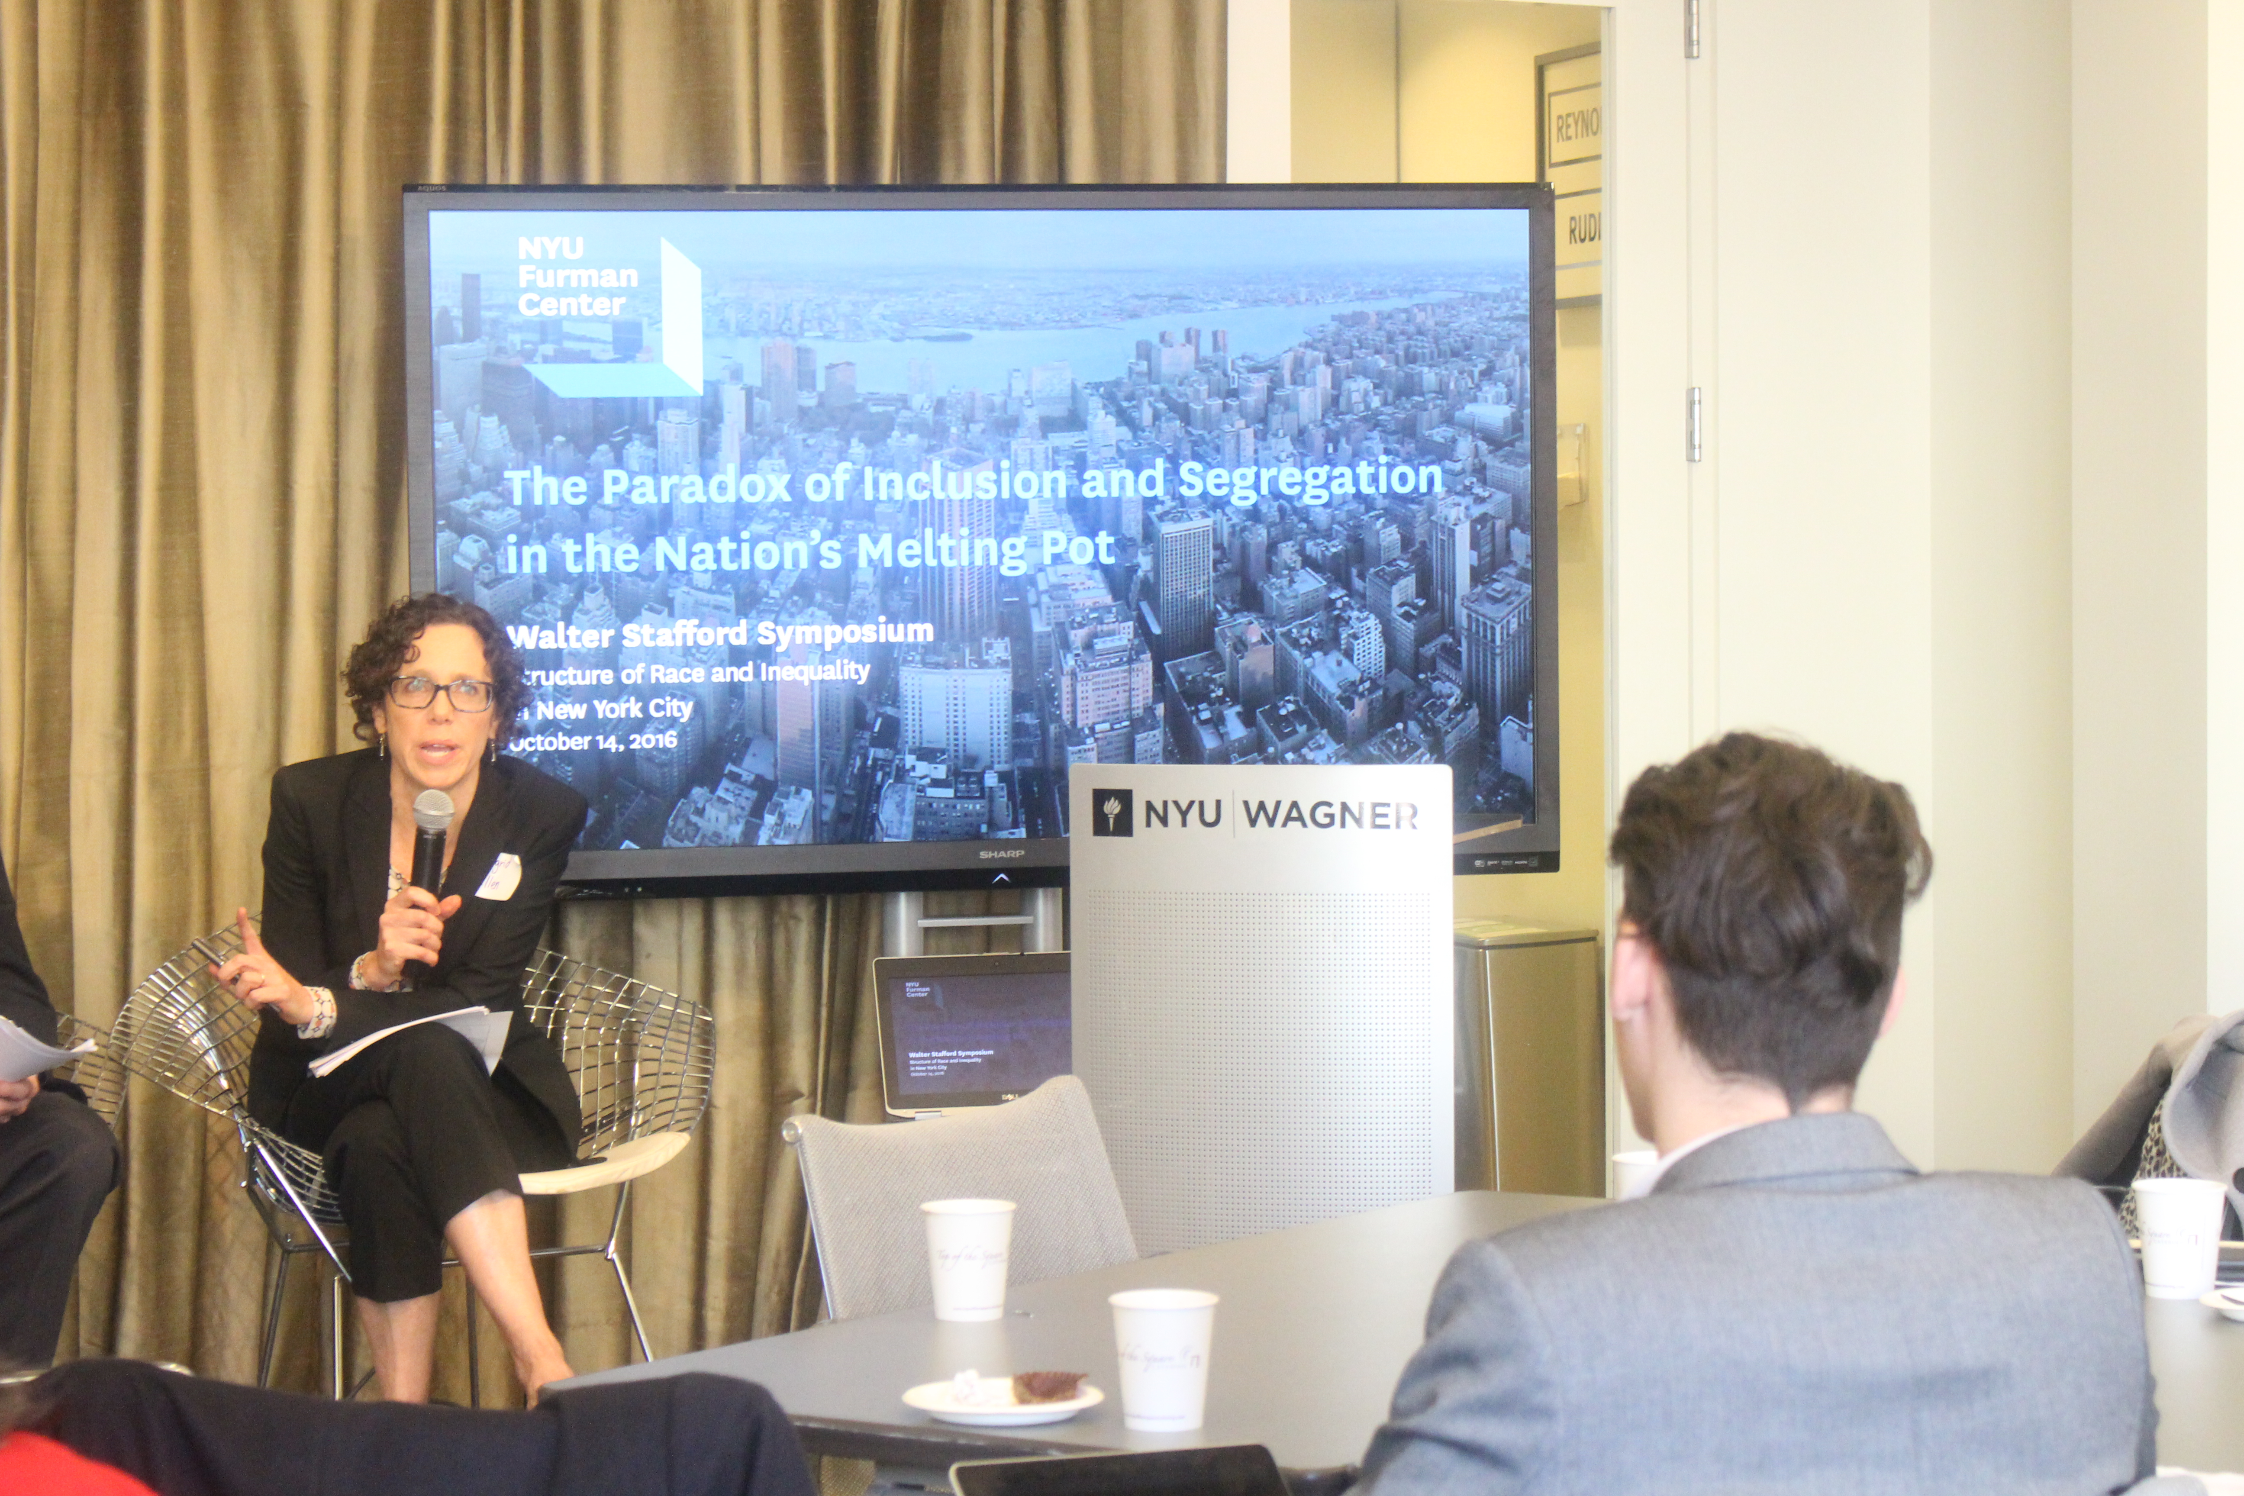
The paradox of inclusion and segregation in the nation’s melting pot presenters: Ingrid Ellen gould, Jessica Yager, and Maxwell Austensen reviewers: Ritchie Torres, rasmia kirmanyi-frye, alex schwartz
1980-2010 NYC becoming more diverse, though not its neighborhoods
3rd most segregated city in the country
Black and Latino population shares falling in Manhattan, rising in outerboroughs
Neighborhoods of color with high rates of crime, and poverty, and lower levels of education
Gentrification complicating narrative of inclusion over segregation, as communities of color are facing displacement and gentrification through inclusion of white/affluent residents

Slide 23
Public housing: new york’s third city presenters: Victor Bach, community service society reviewers: Ritchie Torres, city council, rasmia kirmanyi-frye, director of public/private partnerships at Nycha, alex schwartz, milano school
NYCHA population more than cities like Miami and Atlanta; ‘sleeping giant’ of over half a million voters and taxpayers
Income and employment diversity exists in NYCHA despite poverty narrative
NYC public housing facing an infrastructure and budget crisis
Decades of federal disinvestment, and little city & state funding
Public housing often seperated/disconnected from current affordable housing discourse; NYCHA as last/only truly affordable housing in NYC

Slide 24
Ritchie Torres, new york city council
Public housing often seperated/disconnected from current affordable housing discourse; NYCHA as last/only truly affordable housing in NYC
‘Innovative’ ways to find funding thru NYCHA NextGen; includes market rate development on public grounds to plug budget gap; trades on gentrification to extract profit
Disinvestment and gentrification of NYCHA legacy of structural racism with NYCHA being majority low-income residents of color
Perceived failure of public housing encouraged disinvestment, with racially fueled stigma of crime and disrepair; tied to its working class residents of color

Slide 25
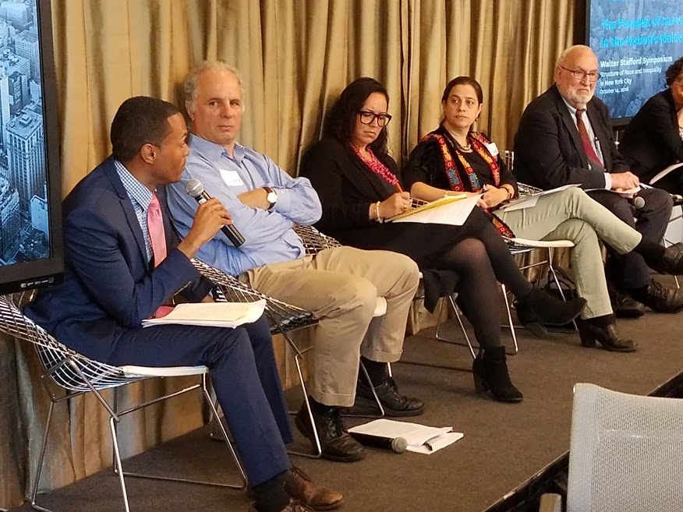
From left to right: ritchie torres, alex schwartz, rasmia kirmani-frye, sondra youdelman, victor bach

Slide 26
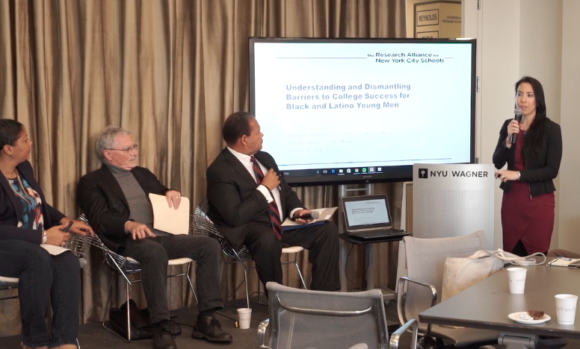
Understanding and Dismantling Barriers to College and Career Success for Black and Latino Young Men presented by: Adriana Villavicencio, Shifra Goldenberg, & Sarah Klevan, research alliance for new york city schools reviewed by: Rudy crew, president of medgar evers college, Zakiyah ansari, ny state alliance for quality education, david kirkland, metropolitan center
Research Alliance to improve school culture and racial gaps
Racial gaps in education persist regardless of existing proficiency of student; points to structural inequality in NYC school system
Achievement gap fed by an Opportunity gap for youth of color

Slide 27
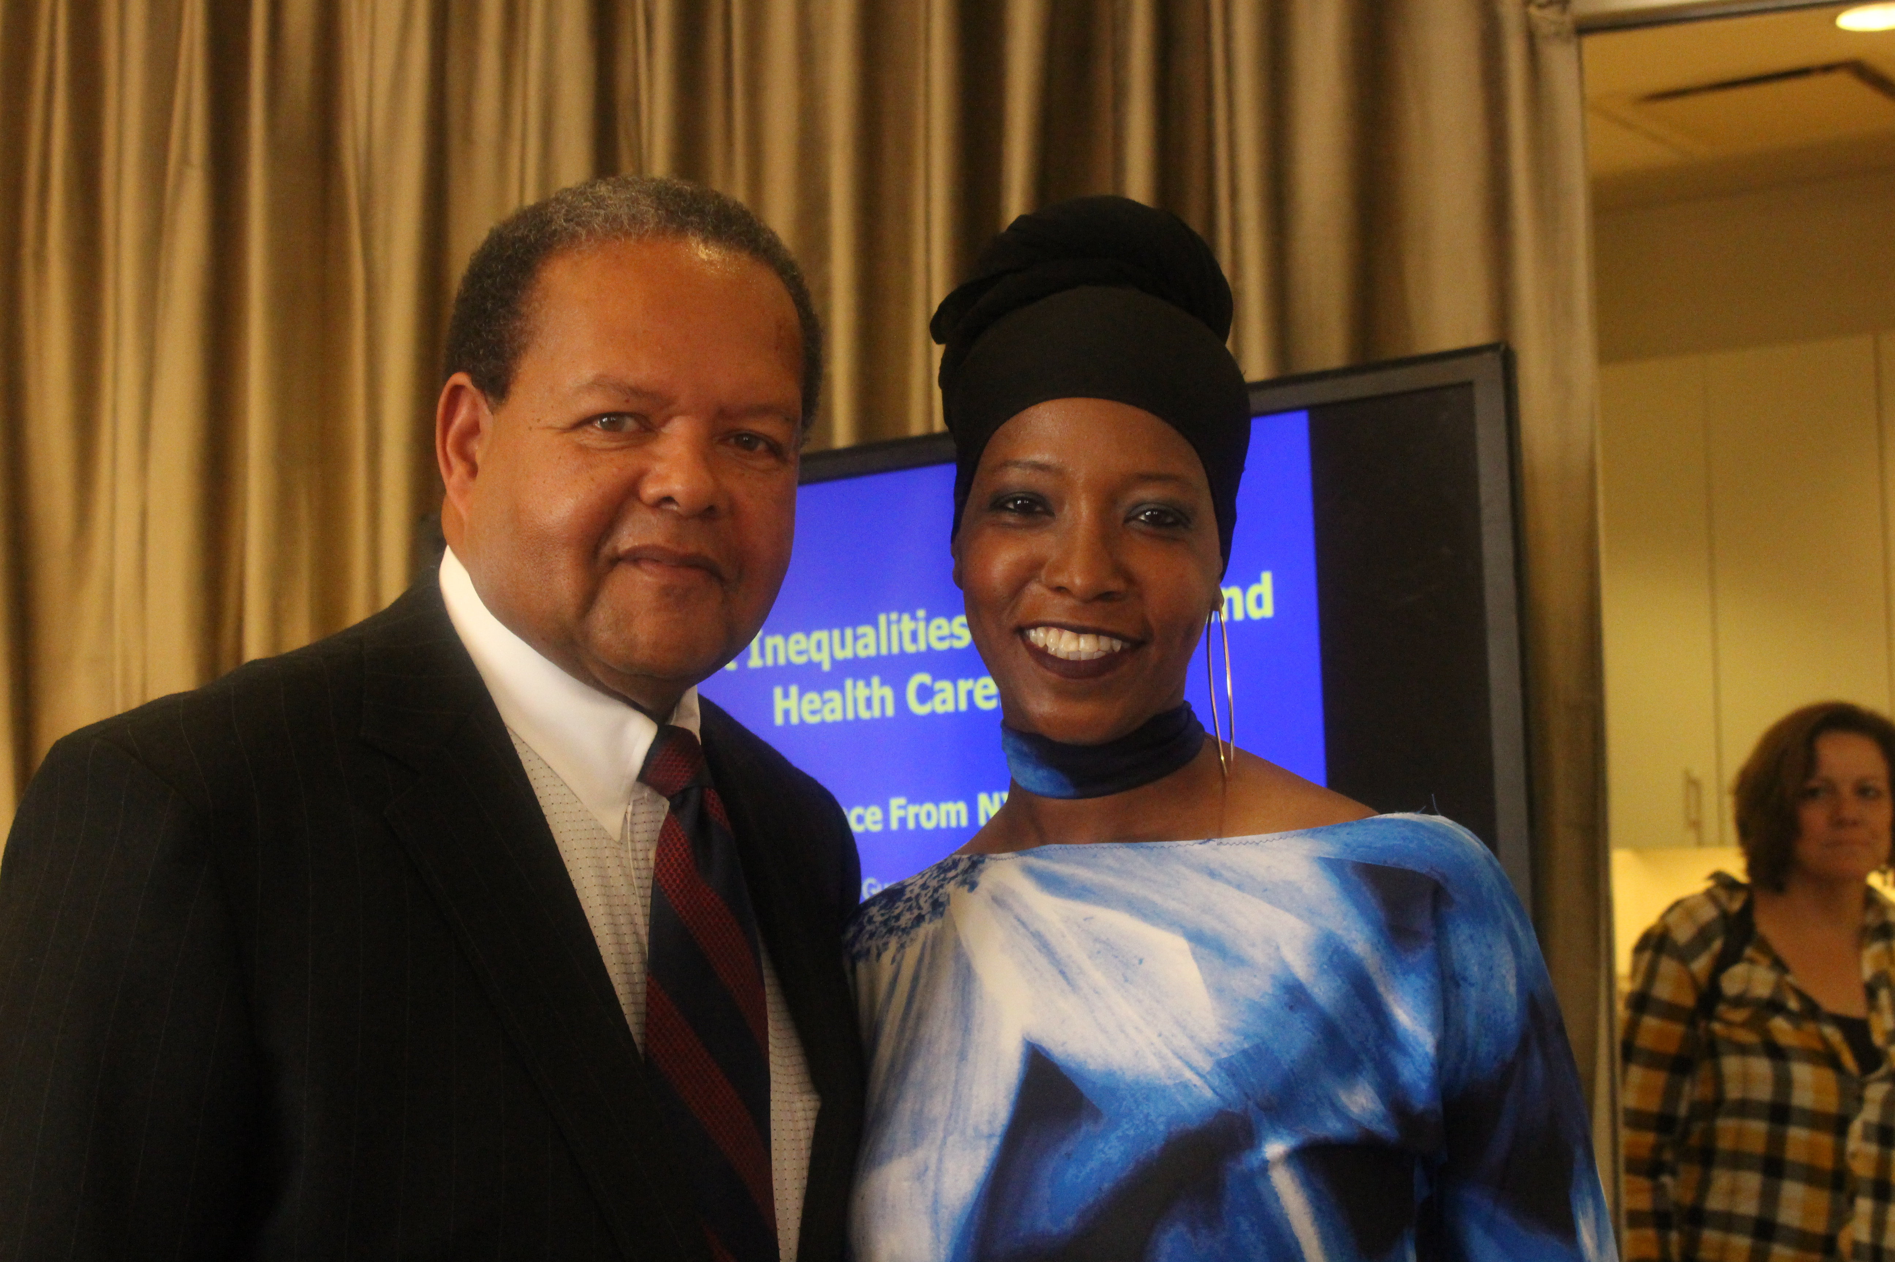
Rudy crew, medgar evers college, Zakiyah ansari, ny state alliance for quality education (pictured below)
NYC school system broken pre and post ‘decentralization’
System not equipped to support large scale intervention
Lack of political will for comprehensive, equitable public school change
Needs high expectations for performance, a variety of learning paths and methods, and an emphasis on love & compassion

Slide 28
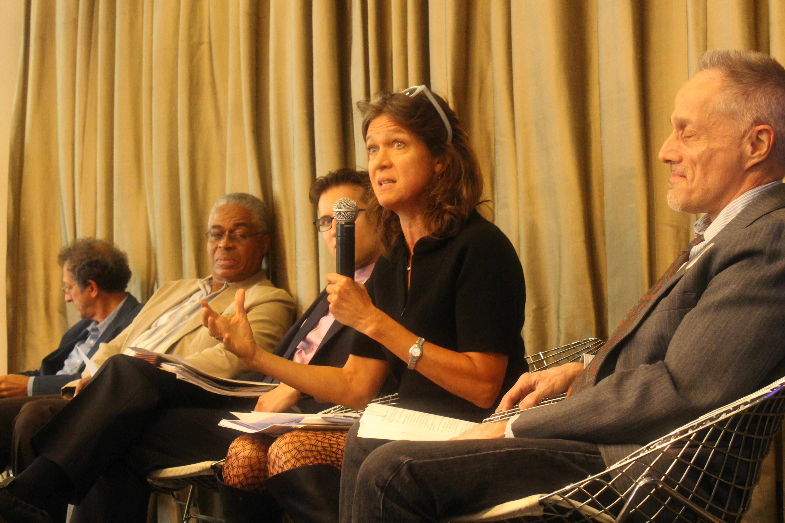
Persistent inequalities in health presented by: victor rodwin, michael gusmano, daniel weisz, world cities project reviewed by: elisabeth benjamin, community service society, mark hannay, metro new york health care for all, steve newmark, senior health policy advisor to the mayor
Compares NYC health systems with other world cities
Overall health, as well as life expectancy lowered for POC and low-income people
2.5% of NYC kids uninsured
Contemporary healthcare closer to ‘sick care’; rather than holistic health and preventative care
NYC structural inequality physically embodied in people of color; literally makes particular people and places more vulnerable to illness, and lack of adequate access to care
Pictured from left to right: Victor Rodwin, Benjamin Bowser, Steve Newmark, Elisabeth Benjamin, Mark Hannay

Slide 29
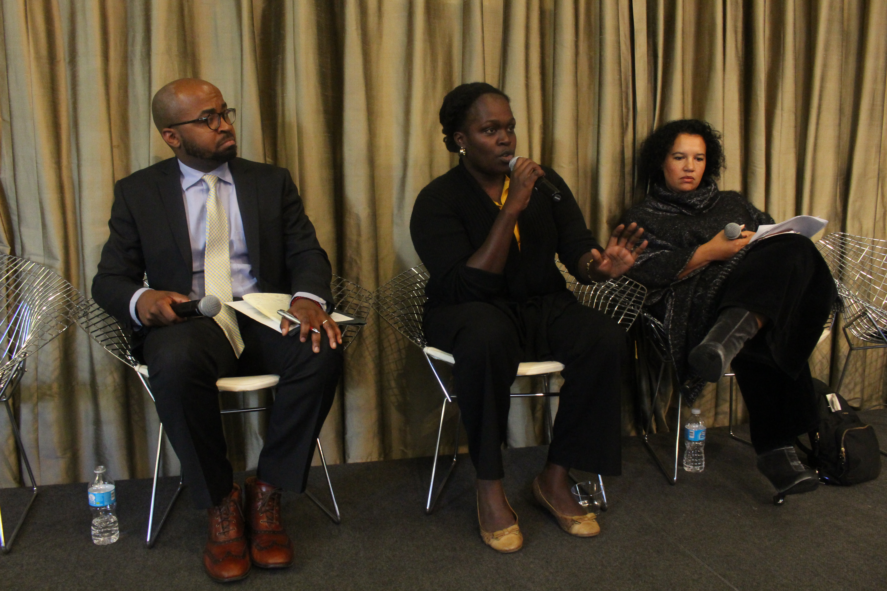
Social Capital and the Politics of Inequality
PRESENTED BY ROBERT HAWKINS, Mcsilver institute for poverty studies at nyu
Presupposes sharing of resources with those who do not
Social capital means of building power and resources among and within communities
Advocates for increase in resourced individuals to share and network opportunity with less resourced, more isolated people
Pictured from left to right: respondents, Andrew Wilkes, Afua Attah-Mensa, Elinor Tatum

Slide 30
Special thanks to James Rodgriuez for his summary, Arthur Paris and Kendra Williams for their photos, and Chelli Devadutt and Benjamin Bowser for co-convening.

